Slide 1
Introduction to Control Systems

Slide 2
Objectives
To possess a basic understanding of control system engineering and be able to offer some illustrative examples and their relationship to key contemporary issues
To be able to recount a brief history of control systems and their role in society
To be capable of discussing the future of controls in the context of their evolutionary pathways
To be to recognize the elements of control system design and possess an appreciation of controls in the context of engineering design

Slide 3
Introduction to Control Systems
CONTROL
A word usually taken to mean regulate, direct, or command.
SYSTEM
It is an arrangement, set, or collection of things connected or related in such a manner as to form an entirety or whole.
It is an arrangement of physical components connected or related in such a manner as to form and/or act as an entire unit.
An interconnection of elements and devices for a desired purpose.

Slide 4
Introduction to Control Systems
An arrangement of physical components connected or related in such a manner as to command, direct or regulate itself or another system.
An interconnection of components forming a system configuration that will provide a desired response.
It consists of subsystems and processes (or plants) assembled for the purpose of controlling the output or process.
In its simplest form, a control system provides an output or response for a given input or stimulus.

Slide 5
Introduction to Control Systems
Input; Stimulus Output; Response
PROCESS
Desired Response Actual Response

Slide 6
Introduction to Control Systems
INPUT
It is the stimulus, excitation, or command applied to a control system, typically from an external source, usually in order to produce a specified response from the control system.
OUTPUT
It is the actual response obtained from the control system. It may or may not be equal to the specified response implied by the input.
PROCESS
The device, plant, or system under control. The input and output relationship represents the cause-and-effect relationship of the process.

Slide 7
Introduction to Control Systems
CONTROLLED VARIABLE
It is the quantity or condition that is measured and controlled.
It is normally the output of the system.
MANIPULATED VARIABLE
It is the quantity or condition that is varied by the controller so as to affect the value of the controlled variable.
PLANTS
It may be a piece of equipment, perhaps just a set of machine functioning together, the purpose of which is to perform a particular operation.
It is a system to be controlled.
DISTURBANCES
A signal that tends to adversely affect the value of the output of a system.

Slide 8
GENERAL CLASSIFICATION OF CONTROL SYSTEM
Control systems are classified into two general categories:
Open-Loop Control Systems
Closed-Loop Control Systems
The distinction is determined by the control action, that quantity responsible for activating the system to produce the output. The word action doesn’t always directly imply change, motion, or activity.

Slide 9
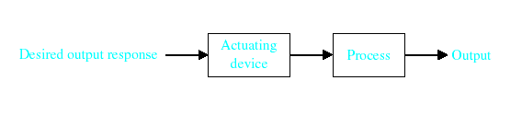
OPEN LOOP
The control action is independent of the output.
Open-Loop Control Systems utilize a controller or control actuator to obtain the desired response.
Functional Block Diagram
Physical Arrangement
Command Input
Output
Reference Selector
Dynamic Unit
Input
Output
Controller
Motor Powering Device

Slide 10
Two Outstanding Features of Open-Loop Control System
1. Their ability to perform accurately is determined by their calibration. To calibrate means to establish or reestablish the input-output relation to obtain a desired system accuracy.
2. They are not usually troubled with problems of instability.
Example of Open-Loop Control System
Most automatic toasters are open-loop systems because they are controlled by a timer. The time required to make “good toast” must be estimated by the user, who is not part of the system. Control over the quality of toast (the output) is removed once the time, which is both the input and the control action, has been set. The time is typically set by means of a calibrated dial or switch.

Slide 11
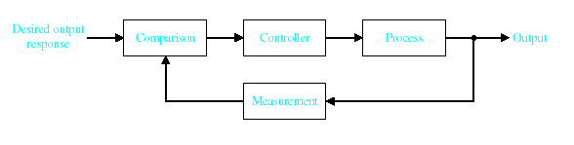
CLOSED LOOP
The control action is somehow dependent on the output. It is commonly called feedback control system.
utilizes feedback to compare the actual output to the desired output response.
Functional Block Diagram
Physical Arrangement
Command Input
Output
Reference Selector
Dynamic Element
Feedback Element
Input
Output
Error Detector
Controller
Powering Device
Output Measuring Device
Output or Load

Slide 12
FEEDBACK
It is the property of a closed loop system which permits the output (or some other controlled variable) to be compared with the input to the system (or an input to some other internally situated component or subsystem) so that the appropriate control action may be performed as some function of the output and input.
Characteristics of Feedback
Increased accuracy.
Tendency toward oscillation or instability.
Reduced sensitivity of the ratio of output to input to variations in system parameters and other characteristics.
Reduced effects of nonlinearities.
Reduced effects of external disturbances or noise.
Increased bandwidth. The bandwidth of the system is a frequency response measure of how well the system responds to (or filters) variations (or frequencies) in the input signal.

Slide 13
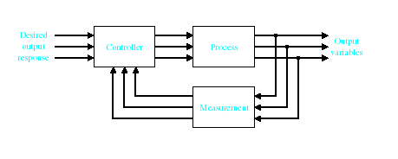
Multivariable Control System
Example of Closed-Loop Control System
An autopilot mechanism and the airplane it controls is a closed-loop (feedback) control system. Its purpose is to maintain a specified airplane heading, despite atmospheric changes. It performs this task by continuously measuring the actual airplane heading, and automatically adjusting the airplane control surfaces (rudder, ailerons, etc.) as to bring the actual airplane heading into correspondence with the specified heading. The human pilot or operator who presets the autopilot is not part of the control system.

Slide 14
Brain Exercises
Determine whether the system is open loop or closed loop system and identify the INPUT and OUTPUT of the system.
An electric switch is a manufactured control system, controlling the flow of electricity. By definition, the apparatus or person flipping the switch is not a part of this control system.
A thermostatically controlled heater or furnace automatically regulating the temperature of a room or enclosure is a control system.
A part of the human temperature control system is the perspiration system. When the temperature of the air exterior to the skin becomes too high the sweat glands secrete heavily, inducing cooling of the skin by evaporation. Secretions are reduced when the desired cooling effect is achieved, or when the air temperature falls sufficiently.
Notes:
Determine whether the system is open loop or closed loop system
1. An electric switch is a manufactured control system, controlling the flow of electricity. By definition, the apparatus or person flipping the switch is not a part of this control system.
The input to this system is the flipping of the switch On or Off.
The output is the flow or nonflow of electricity.

Slide 15
Examples of Control Systems
A thermostatically controlled heater or furnace automatically regulating the temperature of a room or enclosure is a control system.
The input to this system is a reference temperature, usually specified by appropriately setting a thermostat.
The output is the actual temperature of the room or enclosure.
When the thermostat detects that the output is less than the input, the furnace provides heat until the temperature of the enclosure becomes equal to the reference input. Then the furnace is automatically turned off.
When the temperature falls somewhat below the reference temperature, the furnace is turned on again.

Slide 16
Examples of Control Systems
A part of the human temperature control system is the perspiration system. When the temperature of the air exterior to the skin becomes too high the sweat glands secrete heavily, inducing cooling of the skin by evaporation. Secretions are reduced when the desired cooling effect is achieved, or when the air temperature falls sufficiently.
The input to this system may be “normal” or comfortable skin temperature, a “setpoint,” or the air temperature, a physical variable.
The output is the actual skin temperature.

Slide 17
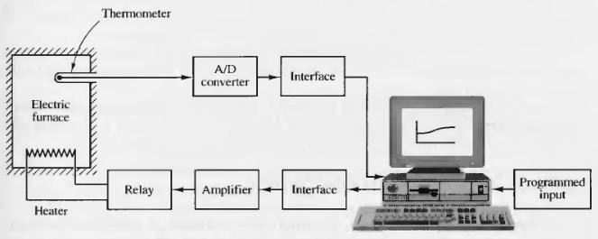
Brain Exercises
TEMPERATURE CONTROL SYSTEM

Slide 18
Brain Exercises
4. Devise a control system to fill a container with water after it is emptied through a stopcock at the bottom. The system must automatically shut off the water when the container is filled.
5. Devise a simple control system which automatically turns on a room lamp at dusk, and turns it off in daylight.

Slide 19
Pulleys
Cords
Stopper
Container
Water
Stopcock
Ball Float

Slide 20
EXAMPLES OF CONTROL SYSTEMS
OPERATION
The ball floats on the water. As the ball gets closer to the top of the container, the stopper decreases the flow of water. When the container becomes full, the stopper shuts off the flow of water.

Slide 21
EXAMPLES OF CONTROL SYSTEMS
Devise a simple control system which automatically turns on a room lamp at dusk, and turns it off in daylight.

Slide 22
Room
Lamp
Window
Photocell facing outdoors
Receptacles

Slide 23
EXAMPLES OF CONTROL SYSTEMS
OPERATION
At dusk, the photocell, which functions as a light-sensitive switch, closes the lamp circuit, thereby lighting the room. The lamp stays lighted until daylight, at which time the photocell detects the bright outdoor light and opens the lamp circuit.

Slide 24
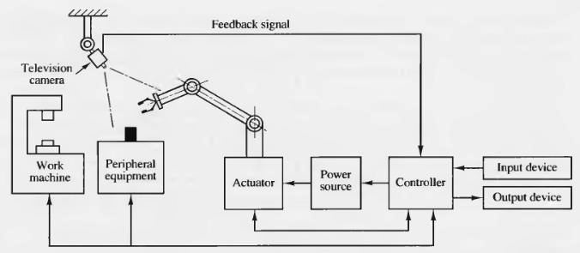
EXAMPLES OF CONTROL SYSTEMS
ROBOT USING A PATTERN-RECOGNITION

Slide 25
CHALLENGER
Register and Login to your Edmodo account HOMEWORK 1 is already posted in the group.
Notes:
Do activity 1.0

Slide 26
FOUR PRIMARY REASONS FOR CONTROL SYSTEM
Power amplifier
For example, a radar antenna, positioned by the low-power rotation of a knob at the input, requires a large amount of power for its output rotation.
Remote control
For example, a remote-controlled robot arm can be used to pick-up material in a radioactive environment.
Notes:
Power Amplification (Gain)
Positioning of a large radar antenna by low-power rotation of a knob
Remote Control
Robotic arm used to pick up radioactive materials

Slide 27
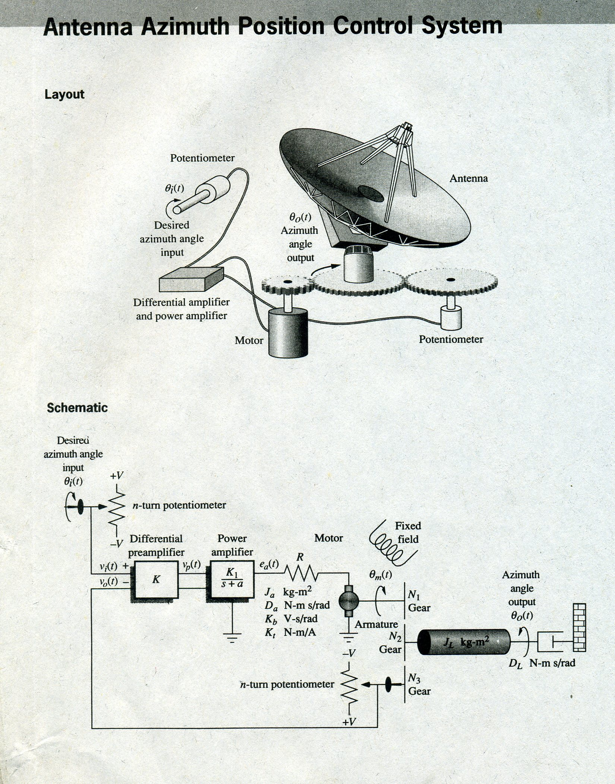

Slide 28
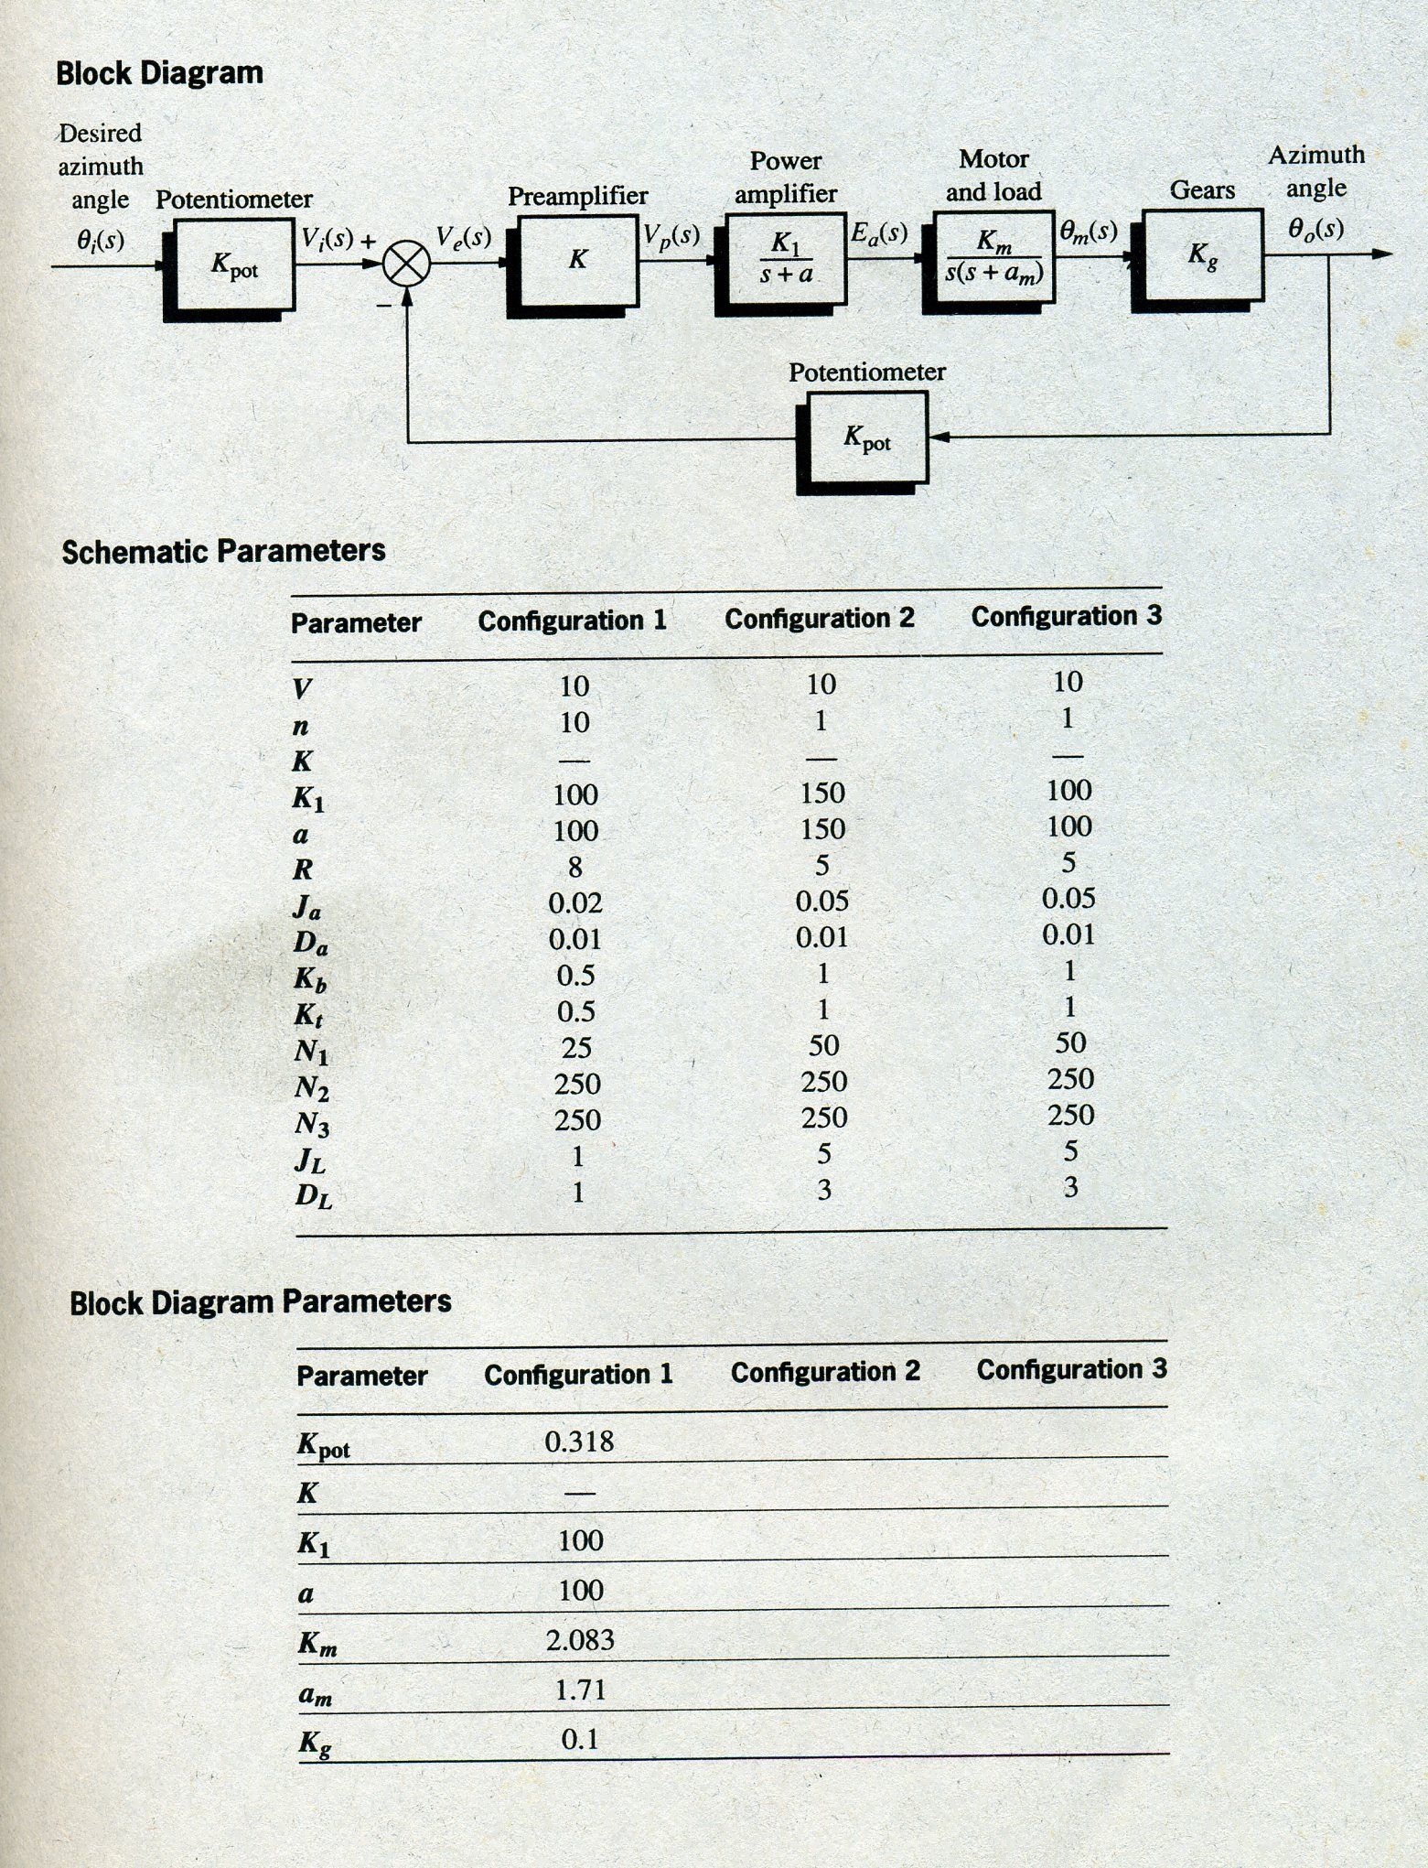

Slide 29
FOUR PRIMARY REASONS FOR CONTROL SYSTEM
Convenience of input form
For example, in a temperature control system, the input is a position on a thermostat and the output is a heat. Thus, a convenient position input yield a desired thermal output.
Compensate for disturbances
Typically, we control variables as temperature in thermal systems, position and velocity in mechanical systems, and voltage, current, or frequency in electrical system.
Notes:
Convenience of Input Form
Changing room temperature by thermostat position
Compensation for Disturbances
Controlling antenna position in the presence of large wind disturbance torque

Slide 30
FOUR PRIMARY REASONS FOR CONTROL SYSTEM
The system must be able to yield the correct output even with a disturbance. For example, consider an antenna system that points in a commanded direction. If a wind forces the antenna from its commanded position, or if noise enters internally, the system must be able to detect the disturbance and correct the antenna’s position.
Obviously, the system’s input will not change to make the correction. Consequently, the system itself must:
1. measure the amount that the disturbance has repositioned the antenna, and
2. return the antenna to the position commanded by the input.

Slide 31
GENERAL CLASSIFICATION OF CONTROL SYSTEM
Problems
How are the following open-loop systems calibrated:
A. automatic washing machine?
B. automatic toaster?
C. ohmmeter?
Explain how a closed-loop automatic washing machine might operate.

Slide 32
ANALOG AND DIGITAL CONTROL SYSTEMS
The signals in a control system, for example, the input and the output waveforms, are typically functions of some independent variable, usually time, denoted t.
Analog Signal
A signal dependent on a continuum of values of the independent variable t.
It is also known as a continuous-time signal or, more generally, a continuous-data signal.
Digital Signal
A signal defined at, or of interest at, only discrete (distinct) instants of the independent variable t (upon which it depends).
It is also called a discrete-time, a discrete-data, or a sampled-data signal.

Slide 33
ANALOG AND DIGITAL CONTROL SYSTEMS
The continuous, sinusoidally varying voltage v(t) or alternating current i(t) available from an ordinary household electrical receptacle is a continuous-time (analog) signal, because it is defined at each and every instant of time t electrical power is available from that outlet.
If a lamp is connected to the receptacle and it is switched “on” and then immediately “off” every minute, the light from the lamp is a discrete-time signal, “on” only for an instant every minute.
The signals inside digital computers and microprocessors are inherently discrete-time, or discrete-data, or digital (or digitally coded) signals. At their most basic level, they are typically in the form of sequences of voltages, currents, light intensities, or other physical variables, at either of two constant levels.

Slide 34
ANALOG AND DIGITAL CONTROL SYSTEMS
Control systems can be classified according to the types of signals they process: continuous-time (analog), discrete-time (digital), or a combination of both (hybrid).
Continuous-Time Control Systems
Also called continuous-data control systems, or analog control systems, contain or process only continuous-time (analog) signals and components.
Discrete-Time Control Systems
Also called discrete-data control systems, or sampled-data control systems, have discrete-time signals or components at one or more points in the system.

Slide 35
THE CONTROL SYSTEMS ENGINEERING PROBLEM
Control systems engineering consists of analysis and design of control systems configurations.
Analysis
It is the investigation of the properties of an existing system.
Design
It is the choice and arrangement of system components to perform a specific task.

Slide 36
THE CONTROL SYSTEMS ENGINEERING PROBLEM
Design by Analysis
It is accomplished by modifying the characteristics of an existing or standard system configuration.
Design by Synthesis
It is by defining the form of the system directly from its specifications.

